Slide 1
Adaptive Cruise Control
An Overview
13 June 2023 | Akshay Chikhalkar and Mohamed Bassam Kassabji

Slide 2
Summary
Motivation
Introduction
System Requirements
Architecture
Features
Limitation
Capabilities
Examples
Outlook

Slide 3
Motivation

Slide 4
Motivation
Safety enhancement
Mitigation of human error
Traffic flow optimization
Fuel efficiency and emissions reduction
Driver comfort and convenience
Technological innovation
Notes:
Safety Enhancement: ACC maintains a safe distance, reducing collisions and rear-end accidents.
Error Mitigation: ACC reduces accidents caused by human errors and inattention.
Traffic Flow Optimization: ACC adjusts speed for smoother traffic flow, reducing congestion.
Fuel Efficiency and Emissions Reduction: ACC optimizes fuel consumption and lowers emissions.
Driver Comfort: ACC minimizes speed adjustments, reducing driver fatigue.
Technological Innovation: ACC showcases advancements in intelligent transportation systems.

Slide 5
What is ACC?
“Adaptive cruise control (ACC) is a type of advanced driver-assistance system for road vehicles that automatically adjusts the vehicle speed to maintain a safe distance from vehicles ahead” *
* https://en.wikipedia.org/wiki/Adaptive_cruise_control
Notes:
increasing complexity of modern road environments
including heavy traffic
distractions
driver fatigue

Slide 6
Evolution
2015
Ford
Radar
F150
2007
BMW
"Active Cruise Control Stop-and-Go”
Radar
5 Series (E60)
2012
Volkswagen
Radar
Golf MK7 SE and above
1999
Mercedes
"Distronic”
Radar
S-Class (W220)
2004
Toyota
Radar
Crown Majesta
2008
SsangYong Motor Company
"Active Cruise Control”
Radar
Chairman
2014
Chrysler
"Adaptive Cruise Control with Stop+”
Radar
200
2017
Cadillac
"Super Cruise”
Lidar + Radar
CT6
1992
Mitsubishi
Lidar
Debonair
1997
Toyota
"Laser Adaptive Cruise Control”
Lidar
Celsior
2002
Lancia
Radar
Thesis
2015
Honda
Radar
CR-V (European)
2006
Nissan
"Intelligent Cruise Control”
Radar
Fuga
2017
Toyota
"Toyota Safety Sense P (TSS-P)”
Radar + Camera
1995
Mitsubishi
"Preview Distance Control”
Laser
Diamante
2000
BMW
"Active Cruise Control”
Radar
7 Series - E38
2003
Cadillac
Radar
XLR
2010
Ford
Radar
Taurus
2014
Tesla
Radar + Cameras
Model S
2001
Infiniti
"Intelligent Cruise Control”
Laser
Q45
2005
Mercedes-Benz
"Distronic Plus”
Radar
S-Class (W221)
2009
Hyundai
Radar
Equus
2013
Mercedes
"Distronic Plus with Steering Assist”
Radar + Camera
S-Class (W222)
2015
Volvo
Radar
Notes:
In the 1990s, Mitsubishi and Toyota introduced the first lidar-based distance detection systems without influencing throttle, brakes, or gear shifting
Mercedes, Jaguar, Nissan, and Subaru followed suit with their own versions of ACC, incorporating radar and laser technologies.
In 1999, Mercedes introduced "Distronic," the first radar-assisted ACC, followed by BMW's radar-based "Active Cruise Control" in 2000.
Toyota also shifted from laser-based ACC to radar-based ACC in 2003, offering improved functionality, including brake control and low-speed tracking.
Integration of Advanced Features:
full-speed range capability
Volkswagen introduced ACC with lidar and integrated collision avoidance systems, such as Front Assist, to prevent collisions.
Expansion of Sensor Technologies:
Lidar technology was adopted by Cadillac in its "Super Cruise" system, combining radar, cameras, and lidar mapping data for a semi-autonomous driving experience.
Volvo made ACC available across its vehicle lineup, utilizing radar sensors.
Integration of Camera Technology:
Advancements in Semi-Autonomous Features:
hands-free driving

Slide 7
System Requirement
Application Requirements
Distance Control
Speed Control
Traffic Adaptation
User Interface (HMI)
Safety Features
Technology Requirements
Sensor System
Distance Measurement
Speed Measurement
Control System
Braking System Integration
Communication System
Algorithms and Decision-Making
Reliability and Accuracy
Integration with ADAS
Regulatory Compliance
Notes:
Distance Control: ACC should be capable of maintaining a safe and adjustable distance from the vehicle ahead.
Speed Control: The system should adjust the speed of the host vehicle to match the speed of the vehicle in front while maintaining the desired distance.
Traffic Adaptation: ACC should adapt to different traffic conditions, such as highway driving, urban traffic, and stop-and-go situations.
User Interface: ACC should provide a user-friendly interface for drivers to set the desired following distance, activate or deactivate the system, and adjust the settings
Safety Features: ACC should include safety features like collision warning, automatic emergency braking, and visual or audible alerts to warn the driver of potential hazards.

Slide 8

System Architecture
ACC ECU
Sensor data
Preprocessing
Algorithms
Data fusion
ACC Control Algorithm
Analytics
Troubleshooting and Debugging
HMI
Feedback for System Improvement
Validation and Testing
Sensor Array
Throttle/Break Actuator
Predictive Maintenance
Performance Optimization
Actuators
ACC System Architecture*
*Potential field–based hierarchical adaptive cruise control for semi-autonomous electric vehicle

Slide 9
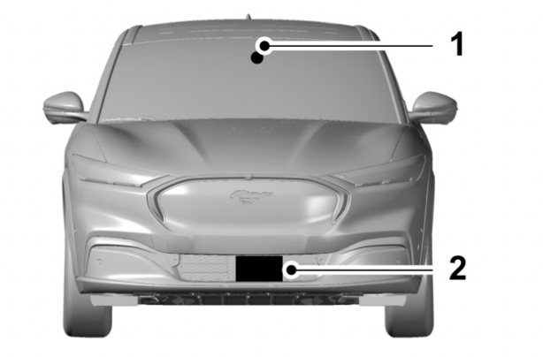
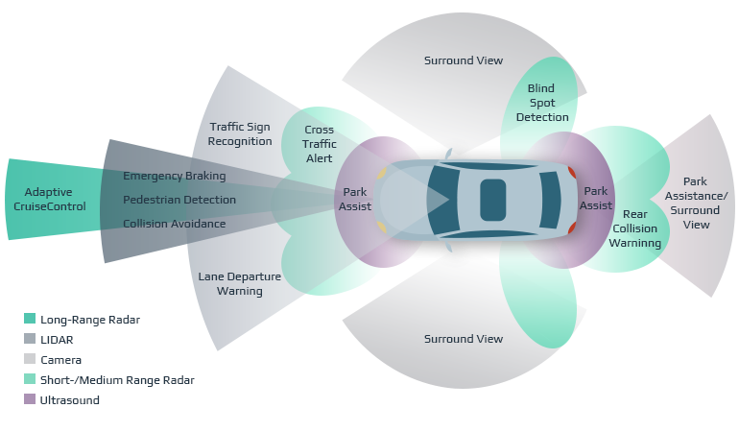
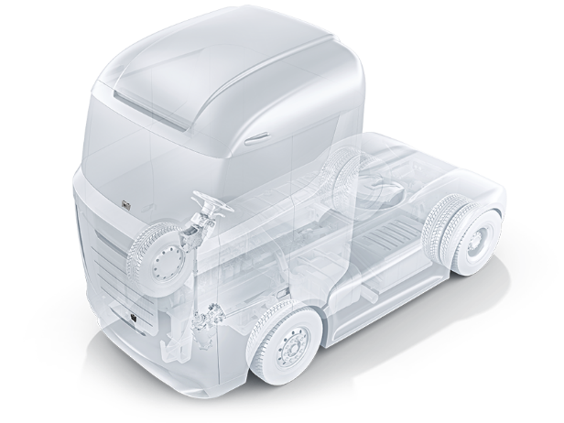
Sensor Array
Sensor Placement
Radar
Long-Range Radar (LRR)
Medium-Range Radar (MRR)
Short-Range Radar (SRR)
Lidar
3D Mapping Lidar
High-Resolution Lidar
Camera
Forward-Facing Camera
Stereo Camera
Infrared (IR) Camera
Camera
Radar
Lidar
Passanger vehicle sensor placement**
1
2
Vehicle Sensors*
Heavy vehicle sensor placement***
*https://www.linkedin.com/pulse/sensor-fusion-advancing-adas-functions-safer-more-efficient-yousif/, **https://pevme.com/ford/2022-ford-mustang-mach-e-adaptive-cruise-control-guide/, ***https://driverguide.volvotrucks.com/lang/en/chassi/Z0000FE/topic/178102/

Slide 10
Perception Algorithms
Perception Algorithms
Object detection
Object classification
Lane detection
Traffic sign recognition
Object Detection*
Lane detection*
*https://www.mitsubishicars.com/cars-and-suvs/mirage

Slide 11
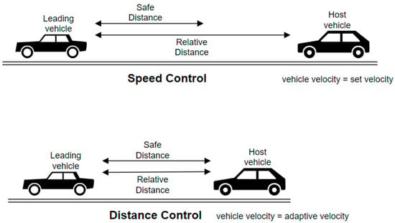
ACC Control Algorithm
Speed Control
Host vehicle travels at a driver-set speed.
Control goal is to track the driver-set velocity (V_set).
Distance Control
Host vehicle maintains a safe distance from the lead car.
Control goal is to maintain the safe distance (D_safe).
Mode selection
Decides the mode based on real-time radar measurements.
If the lead car is too close, switches from speed control to distance control.
If the lead car is further away, switches from distance control to speed control.
Operating rules
If D_rel greter than D_safe, speed control mode is active.
If D_rel less than D_safe, distance control mode is active.
Working modes of adaptive cruise control*
*Adaptive Cruise Control in Electric Vehicles with Field-Oriented Control

Slide 12
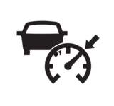
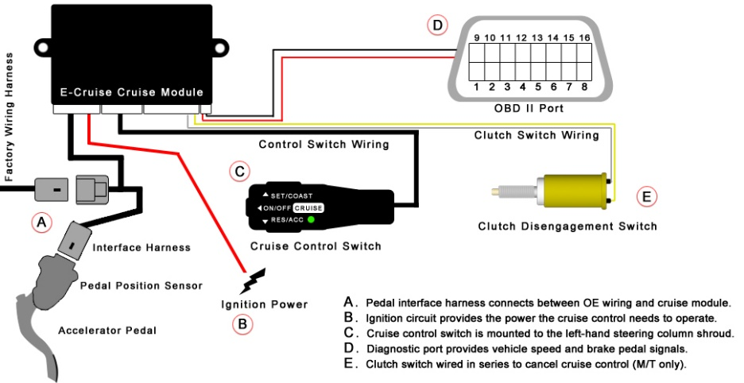
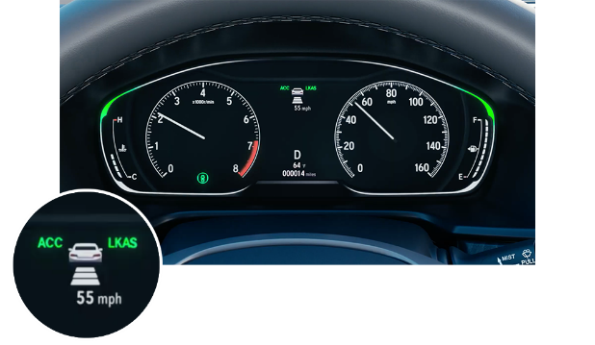
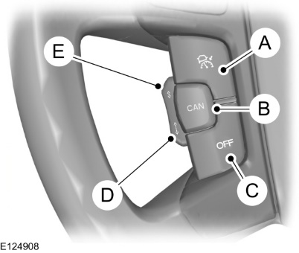
HMI & OBD
Human-Machine Interface (HMI)
Display (Instrument cluster)
Auditory alerts
Control interface
On-board Diagnostic (OBD)
System health monitoring
Fault detection and mitigation
Fail-safe measures
Display Instrument Cluster*
Stering Control Interface**
*https://www.verneidehondasiouxcity.com/what-is-honda-adaptive-cruise-control-acc/, **https://www.bmw.de/de/shop/ls/dp/ACC_Offer_de
Notes:
Display: Provide visual feedback to the driver, showing the current ACC status, speed, and distance to the vehicle ahead.
Auditory alerts: Issue audible warnings or alerts to inform the driver of system actions or potential hazards.
Control interface: Allow the driver to set or adjust ACC parameters, such as desired speed or following distance.
System health monitoring: Continuously monitor the system's performance, sensor functionality, and overall health.
Fault detection and mitigation: Detect and handle sensor failures, communication errors, or abnormal system behavior to ensure safety.
Fail-safe measures: Trigger warnings, alerts, or automatic actions to maintain safety if critical failures occur.

Slide 13
Data Logging
Data Logging
Data Analysis
Troubleshooting and Debugging
Performance Optimization
Validation and Testing
Predictive Maintenance
Feedback for System Improvement

Slide 14
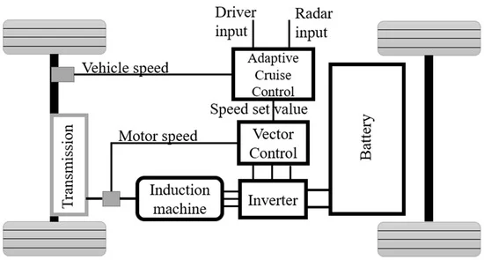
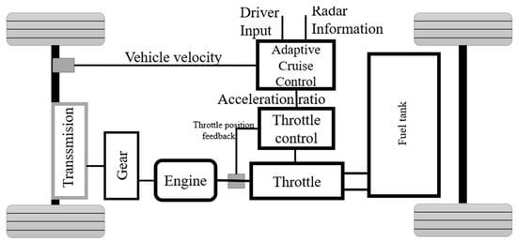
ACC System - EV vs ICE
EV propulsion system with adaptive cruise control.*
ICE propulsion system with adaptive cruise control.*
*Adaptive Cruise Control in Electric Vehicles with Field-Oriented Control

Slide 15
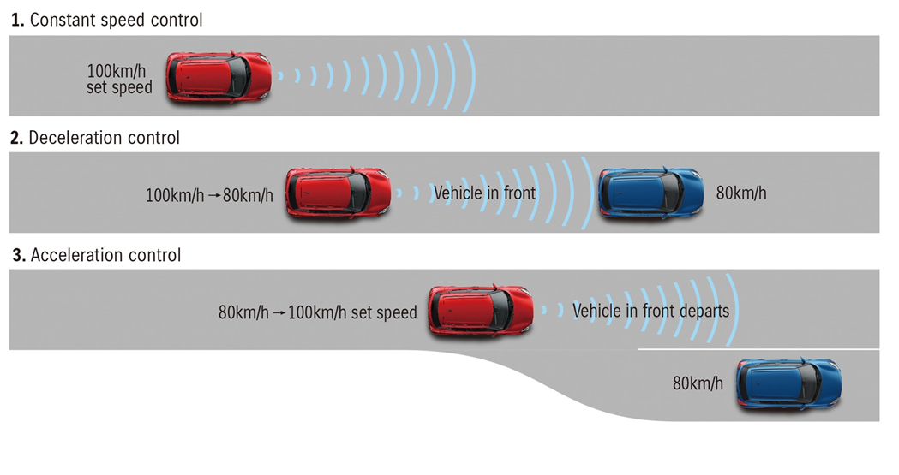
Features
Three main features have been used
Intelligent Collision Avoidance
ACC Stop and go
Automatic Emergency Braking
Lane Keeping Assist
Features*
*https://www.parkers.co.uk/what-is/acc-adaptive-cruise-control/
Notes:
Lane Keeping Assist
In certain vehicles, ACC may work in conjunction with lane keeping assist systems.
This feature helps keep the vehicle within the lane by providing steering input or gentle corrections if the vehicle drifts out of the lane.

Slide 16
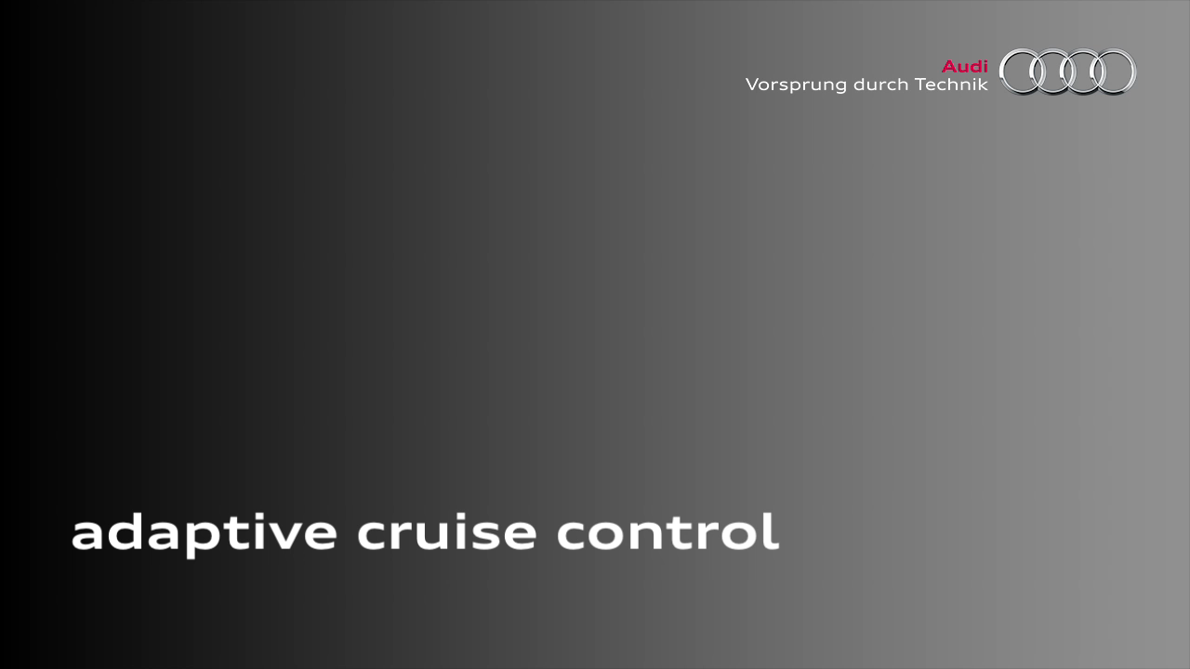
Features
*https://www.audi-technology-portal.de/de/elektrik-elektronik/fahrerassistenzsysteme/adaptive-cruise-control-mit-stop-go-funktion?c=video:177&type=video_sd

Slide 17
Limitations
Human Factor Issues
General Limitations
Sensor Limitations

Slide 18
Limitations
Human Factor Issues
Understanding of the driver’s psychology and behavioral habits.
Human factor issues, such as:
The feeling of losing of control.
Trust of the driver in the automated system.
The mental representation that the driver builds up of the automated system.
Feedback of the state of the system to the driver in an effective manner.
Driver stress.
Notes:
Loss of control, which is the removal of control from the driver
The mental representation …. Expecting more or less
Driver stress, Mental and physical workload associated with automation;

Slide 19
Limitations
The ACC system general limitations
May not operate properly if the sensor is blocked.
May Only warns of vehicles detected by the radar sensor.
May not detect pedestrians or objects on the road.
May not detect oncoming vehicles in the same lane.
The sensors may incorrectly track lane markings as other structures or objects. This can result in a false or missed warning.

Slide 20
Limitations
Sensor Limitations
Geometrical obstructions.
Difficulties in predicting the course far in front of you.
High temperature.
Vehicle speed in the radar unit.
Limited field of vision in the radar unit.
Impaired vision in Camera sensor.
https://www.fordservicecontent.com/Ford_Content/vdirsnet/OwnerManual/Home/Content?variantid=7953&languageCode=en&countryCode=USA&Uid=G2205493&ProcUid=G2205531&userMarket=usa&div=f&vFilteringEnabled=False&buildtype=web
Notes:
Geometrical obstructions
Detection issues can occur due to the road infrastructures, for example bridges, tunnels and safety barriers.
Tops of hills and bottoms of valleys naturally limit the longitudinal range.
The system may brake late or unexpectedly
Difficulties in predicting the course far in front of you
Errors in determining the actual value of the road curvature
Parts of roads with non-constant
Small sensor's field of view and range.
Sudden changes in direction might make accurate predictions difficult
Rapidly changing traffic patterns or road layouts
Vehicle speed in the radar unit
The radar unit's ability to detect a vehicle ahead is greatly reduced if the speed of the vehicle ahead is very different to the speed of your own car.
The system may not detect stationary or slow moving vehicles below 6 mph (10 km/h).
Limited field of vision in the radar unit
The radar unit has a limited field of vision. In some situations another vehicle is not detected, or the detection is made later than expected.
Impaired vision in Camera sensor
may "see" worse in for example in intense snowfall or rain, dense fog, heavy dust storms and snow flurries.
Strong oncoming light, reflections in the carriageway, snow or ice on the road surface, dirty road surfaces or unclear lane markings can also significantly reduce camera function when it is used to scan the carriageway to detect pedestrians, cyclists, large animals and other vehicles.

Slide 21
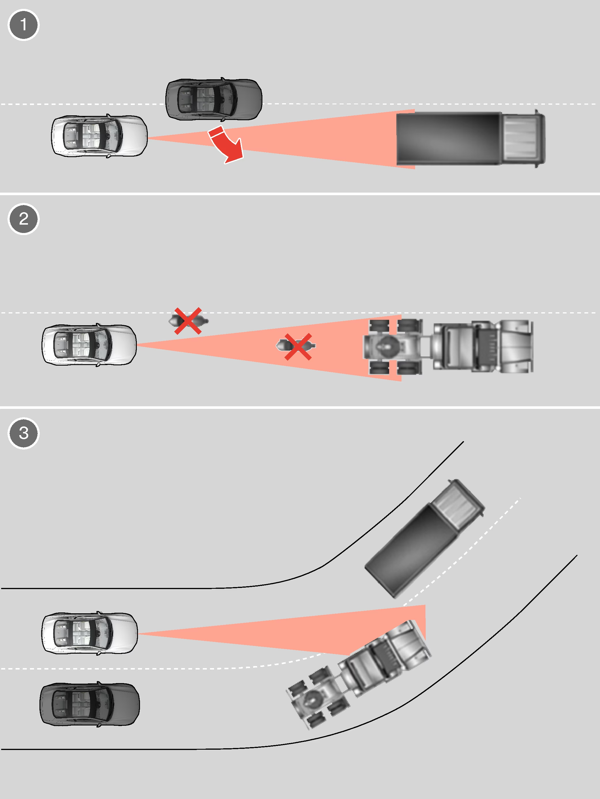
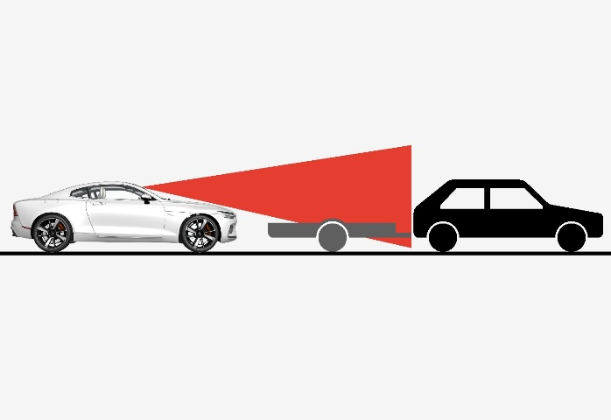
Limitations
Case 1:
Sometimes the radar unit is late at detecting vehicles at close distances - e.g. a vehicle that drives in between your car and the vehicle ahead.
Case 2:
Small vehicles, such as motorcycles, or vehicles not driving in the center of the lane can remain undetected.
Case 3:
In curves, the radar unit may detect a different vehicle than intended or lose a detected vehicle from view.
Case 4:
Low trailer in radar shadow.
Limitaion Cases*
Limitaion Cases**
*https://www.fordservicecontent.com/Ford_Content/vdirsnet/OwnerManual/Home/Content?variantid=7953&languageCode=en&countryCode=USA&Uid=G2205493&ProcUid=G2205531&userMarket=usa&div=f&vFilteringEnabled=False&buildtype=web
**https://www.polestar.cn/uk/manual/polestar-1/2020/article/Limitations-for-camera-and-radar-unit/

Slide 22
Capabilities
Recognition of curve contour
Detect unequivocally stationary objects
Speed limit assistant, etc.

Slide 23
Capabilities
Recognition of curve contour
A curve is characterized by static objects “like guard railings, pillars, trees, buildings, etc.”
Depends on :
Curve detection.
Speed adjustments based on the severity of the curve.
Smooth acceleration and deceleration.
Dynamic steering assistance.
Intelligent curve tracking.
Adaptation to various curve types.
Notes:
Term : The functionality of the system depends on Adaptive Cruise Control's (ACC) capacity to recognize curve shapes.

Slide 24
Capabilities
Detect unequivocally stationary object
Radar, LIDAR, and cameras continuously scan the area, collecting data in real-time and giving a detailed picture of all the objects there.
The algorithms used by ACC have the ability to recognize items and distinguish between fixed and moving objects.
Determine the separation between the host vehicle and stationary objects. To keep a safe following distance.

Slide 25
Capabilities
Adaptive speed assistant
This is done by using:
Sensors to recognize speed restrictions.
Real-time monitoring of speed limits.
Visual display of speed limits to the driver.
Automatic speed modification to fit the detected limits.
Speed limit violation notifications.
For accurate statistics, ACC might additionally incorporate a speed limit database.

Slide 26
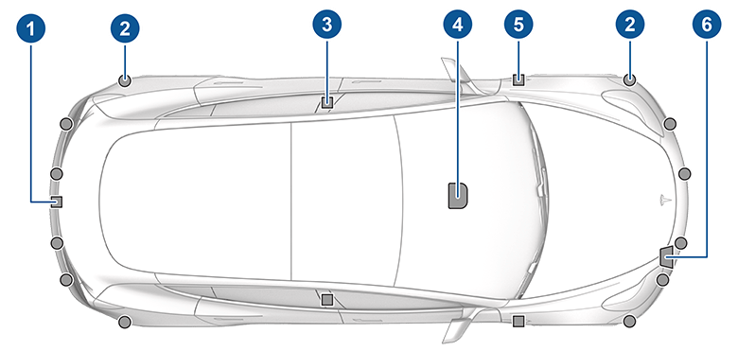
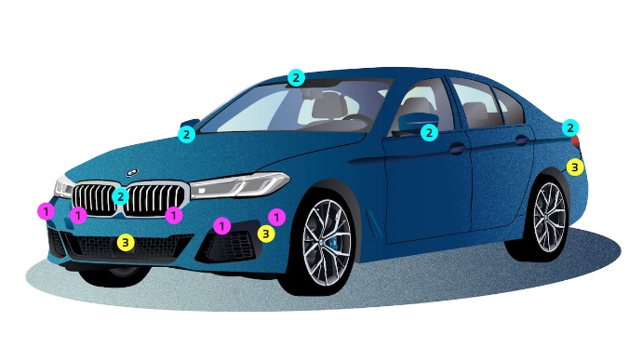
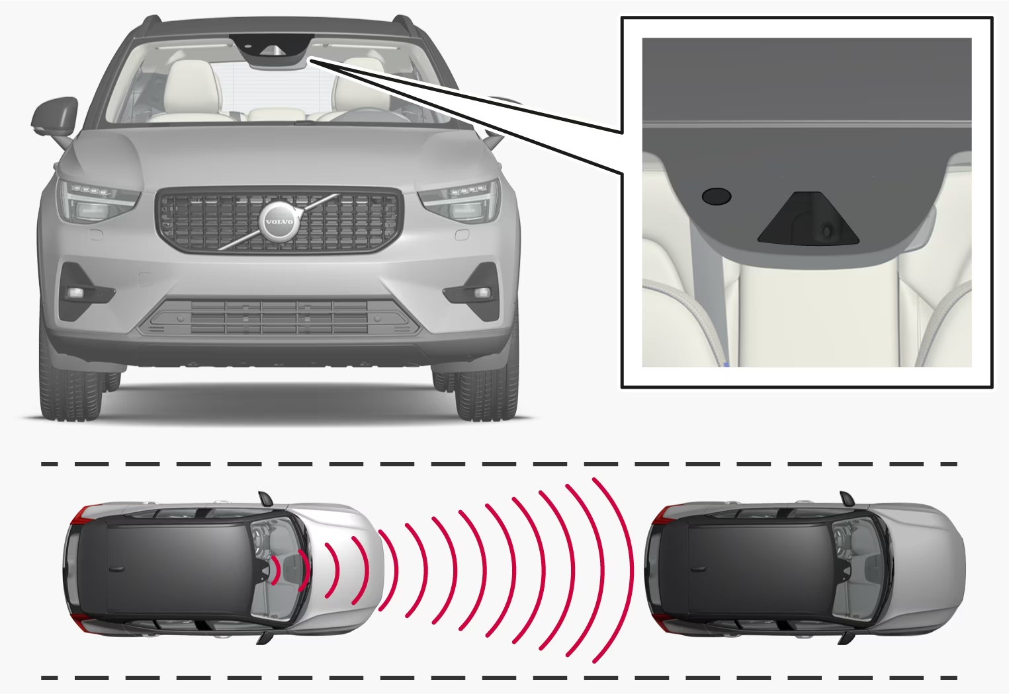
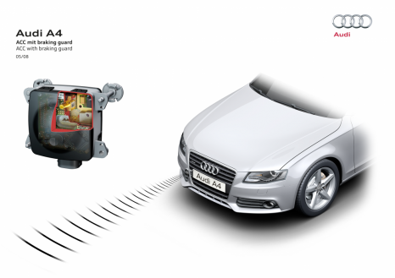
Examples
Tesla
It is called Traffic-Aware Cruise Control (BETA feature).
Multiple Cameras (Ultrasonic and Radar if equipped).
Audi
The Adaptive Cruise Control (with Stop&Go).
It uses two radar sensors installed at the front of the vehicle.
BMW
It is called ACTIVE Cruise Control with Stop&Go.
It uses Ultrasonic, Cameras, Automotive Radar and LIDAR.
VOLVO
It is called Pilot Assist.
It uses utilizes a camera as well as a radar sensor.
Mercedes-Benz
It is called “DISTRONIC, DISTRONIC PLUS, and DISTRONIC PLUS® with Steering Assist”.
Mercedes-Benz uses a radar sensor at the front of the vehicle.
vehicles*
*https://www.volvocars.com/lb/support/car/xc40/article/af42dd367f7db52ec0a80151108cf1cd
*https://www.bmw.com/en/innovation/automotive-sensors.html
*https://www.tesla.com/ownersmanual/model3/en_eu/GUID-EDA77281-42DC-4618-98A9-CC62378E0EC2.html
*https://www.audi-technology-portal.de/en/electrics-electronics/driver-assistant-systems/adaptive-cruise-control-with-stop-go-function
Notes:
-Tesla:
Traffic-Aware Cruise Control is particularly unlikely to operate as intended in the following types of situations:
• The road has sharp curves.
• Visibility is poor (due to heavy rain, snow, fog, etc.).
• Bright light (such as from oncoming headlights or direct sunlight) is interfering with the view of the camera(s).
• A camera or sensor (if equipped) is obstructed (fogged over, dirty, covered by a sticker, etc.).
A camera is mounted above the rear license plate.
Ultrasonic sensors (if equipped) are located in the front and rear bumpers.
A camera is mounted in each door pillar.
Three cameras are mounted to the windshield above the rear view mirror.
A camera is mounted to each front fender.
Radar (if equipped) is mounted behind the front bumper.
Audi:
The ACC stop & go uses two radar sensors installed at the front of the vehicle which are automatically heated when it is cold. They transmit radar waves at a frequency of 76.5 gigahertz covering a roughly 40 degree wedge-shaped field measuring approx. 250 meters (820 ft) in length. A computer processes the signals and thus detects vehicles ahead.
Volvo:
Pilot Assist works in conjunction with the Adaptive Cruise Control system. The standard Volvo Adaptive Cruise Control system utilizes a camera and radar sensor to constantly scan the road ahead and will automatically adjust your speed relative to the vehicle ahead of you. Pilot Assist takes this technology a step further by providing steering assistance to help keep your Volvo in its lane. Now on its second generation, Pilot Assist no longer needs a car to follow for the steering assist to function.
Mercedes-benz:
DISTRONIC PLUS® is an adaptive cruise control technology from Mercedes-Benz. The feature uses built-in radar to bring you up to speed, brake as necessary, and maintain a safe distance from the vehicle in front of you. Compared to a standard cruise control system, DISTRONIC® technology allows for a smoother, simpler touring experience on the highways near Mclean. Today, DISTRONIC PLUS® is available on a wide range of new models including the Mercedes-Benz CLA 250 and the Mercedes-Benz GLA SUV. Ready to learn more about how DISTRONIC PLUS® works? Explore our guide to the feature below, and then schedule a test drive at Mercedes-Benz of Tysons Corner.
Depending on the Mercedes-Benz model that you choose, you’ll receive one of three different versions of the DISTRONIC® feature. Here’s what you should know about each:
DISTRONIC® is the basic adaptive cruise control system. Although it’s identical to DISTRONIC PLUS® in most respects, DISTRONIC® will not bring you to a complete halt. Rather, the feature will pass control back to the driver when your speed drops below 15-20 mph.
DISTRONIC PLUS® stays active, even if your speed drops to zero. In general, while DISTRONIC® might be offered as a standalone feature, DISTRONIC PLUS® is usually offered as part of the Driving Assistance package.
DISTRONIC PLUS® with Steering Assist offers even more advanced convenience. In addition to controlling your speed and follow-distance, this technology keeps track of road lines and limits, along with other vehicles in your periphery. If you start to exit your lane by accident, or try to merge into an occupied space, the feature will intervene to keep you centered.
Although these remarkable technologies will help to make every drive more enjoyable and more relaxing, none is a substitute for the careful attention and focus of the driver. On a similar note, DISTRONIC PLUS® with Steering Assist requires your hands to remain on the wheel at all times. Learn more about Mercedes-Benz safety features with our guides to ATTENTION ASSIST® and Mercedes-Benz PRESAFE®, or find out who owns Mercedes-Benz and learn a little bit about the company’s origins.

Slide 27
Future / Outlook
Functional Improvements
Improving the radar sensor.
Integration Aspects
Enable the use longitudinal control function by separating ACC and ECU.
ACC and Vehicle Dynamic Control (VDC).
Improvements with the navigation system through Predictive Navigation Data
Driver assistance systems
Speed assistant
Object tracking
Improvements through Image processing
Joining a camera and image processing to recognize activity signs and street lines.
Cooperative Collision Avoidance
To empower agreeable communication and coordination in order to anticipate collisions.
Notes:
Functional Improvements Increased longitudinal and lateral range improved object separation capacity
Integration Aspects
It simplifies system interaction, reduces redundancy, and enhances overall vehicle control and performance.
Improvements with the navigation system
Use of navigation system in driver assistance systems
Driving assistance systems can proactively react to road conditions, curves, and intersections by using predictive navigation data, improving the entire driving experience.
Use of predictive road data for speed assistant
The technology can modify the vehicle's speed while taking into consideration the radius and distance of approaching curves by assessing the geometry and curvature of the road.
Use of predictive road data to support the object tracking of the ACC sensor
Improvements through Image processing
The usefulness of Adaptive Cruise Control (ACC) can be improved by joining a camera and an picture preparing framework to recognize activity signs and street lines.
This expansion empowers two key highlights:
activity sign acknowledgment (TSR)
optical discovery of street lines.
Cooperative Collision Avoidance
CCA includes the integration of ACC frameworks over numerous vehicles to empower agreeable communication and coordination in order to anticipate collisions and upgrade by and large security on the street.
Within the future, ACC frameworks can advance to consolidate vehicle-to-vehicle (V2V) and vehicle-to-infrastructure (V2I) communication advances, shaping a agreeable arrange of vehicles.
This arrange can trade real-time data approximately vehicle position, speed, increasing speed, and other pertinent information, permitting for upgraded situational mindfulness and proactive collision shirking measures.

Slide 28
Thank You!

